Slide 1


Foundations of SQL
By Vishwa Patel

Slide 2

About me
Vishwa Patel
Graduated from Dal in Fall 2024!
Full time employee at Bell as Technical Network Architect
Feel free to connect with me on LinkedIn with any questions!

Slide 3

notes
You can take it the way you like or refer to my slides
To make ER diagram use link - https://drawsql.app/diagrams
ER Model - https://erdplus.com/
Notes:
Ice breaker

Slide 4
Course outline
Week 1– Introduction to ER Diagrams
Terminologies
Designing an ER Diagram
Converting ER diagrams to Database
Week 2 – DDL commands and SQL Basics
Creating tables
Inserting data into tables
Week 3 – Joins and Basic Functions
Basic queries
Joins
Aggregate functions
Week 4 – Intermediate SQL concepts
Updating tables
Subqueries
Constraints
Tips and Tricks
6th January
13th January
20th January
27th January
Notes:
Mondays of this month
Connect the course contents
Why we learning
Why are you all here?

Slide 5

Assessment
Project submission required (further details to be provided soon!)
Criteria
Need >85% in the project
75 % minimum attendance required (3/4 in-person classes)
Deadline: 5th Feb 2025
Notes:
Project would contain 3 sections with … percent
Need 85 or more to pass

Slide 6
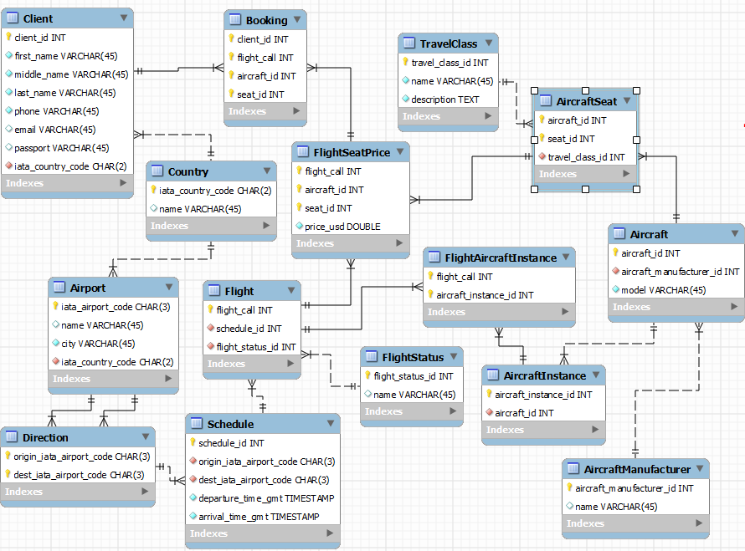
What is database (DB)?
Any collection of related information
Computers make it easier to handle large amounts of data
This Photo by Unknown Author is licensed under CC BY-SA
Notes:
So, tell me what is database?
Phone Book, Shopping list, Facebook’s User base, Amazon
Can be stored on paper, laptop, or even even on your mind!
Why computers make it easier to handle so much data
Handles securely
Easily readable and available
Programming languages to interact with software applications (DBMS)

Slide 7
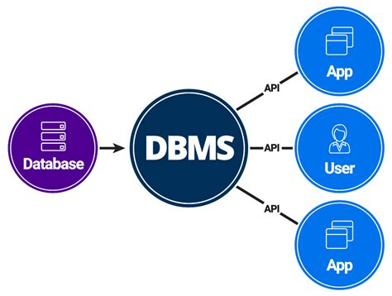
What is DBMS?
Database Management System
Special software program that helps users create and maintain database
Manages security of the data
Backups
Importing/Exporting Data
Easy to manage large amounts of data
Programming language can be used for interacting
Performs CRUD operations – Create, Read/Retrieve, Update, Delete
This Photo by Unknown Author is licensed under CC BY-SA-NC
Notes:
When storing data important to have a management system to take care of the data and make managing easier for us
Read the theory
DBMS performs actions like …
The basic operations that we need to perform on databases are these

Slide 8


Database interaction
Database
Database Management System (DBMS)
Notes:
applications like facebook and many other social media application use dbms to manage their data
as these applications have
millions and billions of data points it can be harder to manage
there comes sql, the lnaguge built to

Slide 9
Types of databases
Relational Database | Non-Relational Database
SQL Database | No SQL/Not only SQL
Organizes data into one or more tables | Any database with information, not a table
Tables have rows and columns, more like excel sheet | Documents like JSON, XML file, etc.
Unique key for each row | Key – value storage

Slide 10
What is RDBMS?
Relational Database Management System
Create and maintain relational databases
Uses SQL – standardized language for interacting with RDBMS
SQL used for CRUD operations and other tasks like administrative, backups, etc.
Used to define tables and structure

Slide 11
DBMS vs RDBMS
DBMS | RDBMS
Stores information as a file | Stores information in tables
Does not link data | Links data using keys, indexes, etc. to create relationships between tables.
Access one data at a time | Interact with multiple data elements at a time
Data redundancy is common | No Data redundancy
Deals with small amount of data | Can efficiently deal with large amounts of data
Example: Windows Registry | Examples: MySQL, PostgreSQL, Oracle, etc.

Slide 12
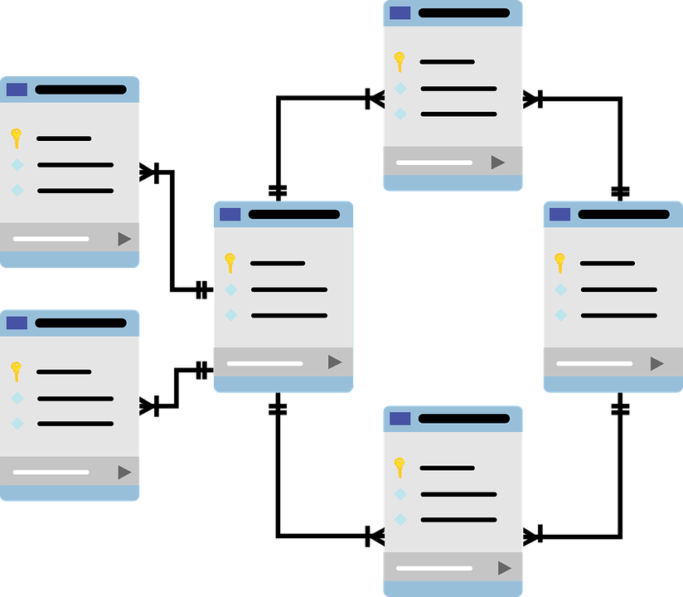
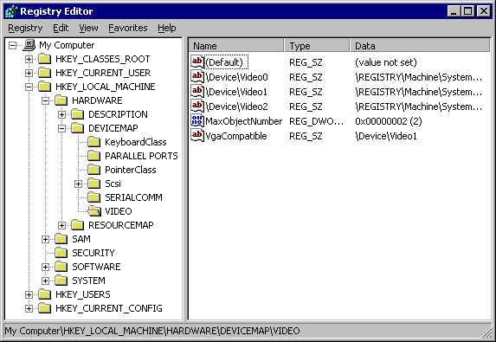
DBMS vs RDBMS
https://cdn.prod.website-files.com/644bb0d49c07b5dc9232d6f0/64aea5086620b6494985c654_Untitled%20(4).png
https://learn.microsoft.com/en-us/windows/win32/sysinfo/structure-of-the-registry

Slide 13
What is NRDBMS?
Non-Relational Database Management System
Helps create and maintain non-relational databases
MongoDB, firebase, etc.
They have their own language defined to communicate with the data

Slide 14
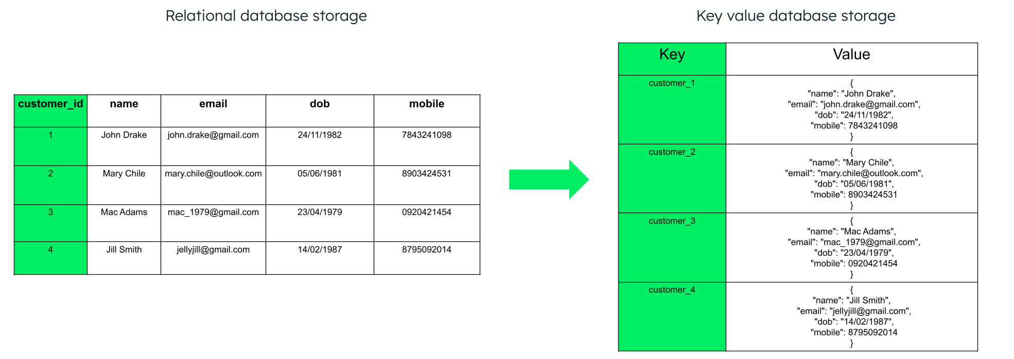
RDBMS vs NRDBMS
https://www.mongodb.com/resources/basics/databases/key-value-database#:~:text=key%2Dbased%20queries-,MongoDB%20as%20a%20key%20value%20store,for%20%E2%80%9Ckey%20value%E2%80%9D%20data.

Slide 15
Any questions?

Slide 16
Introduction to SQL

Slide 17
What is sql?
Developed in 1970s by IBM
Structured Query Language
Interact with Relational Database Management System (RDBMS)
MySQL is widely used as RDBMS
Language to communicate with databases

Slide 18
Why sql?
Faster processing speed
Reliability and efficient
Originally designed for non-programmers, makes it easy to learn
Widely adopted
Easily scalable

Slide 19
Where is sql used?
Widely used in all sectors (Healthcare, Finance, Social Media)
Top companies like Netflix, Instagram, etc. use it for data analysis, database upgrades and maintenance of data.
NASA uses SQL databases to manage space exploration mission’s data
Used in careers like data analysis, engineering and science.

Slide 20
Summary
Databases are nothing but collection of related information.
DBMS to create, manage databases and perform CRUD operations.
Databases are of 2 types, relational and non-relational.
Relational managed by RDBMS like MySQL, etc.
RDBMS stores data using table’s structure whereas NRDBMS stores data is different formats.
SQL is used in data analysis, maintaining the databases.

Slide 21
Build ER Model
Learning terminologies for structuring Relational Database

Slide 22
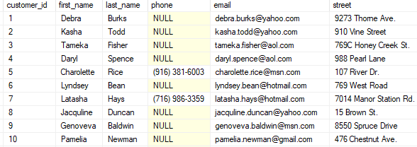
What is table?
It is a structured collection of data
Organized in rows and columns
Each row has a unique ID to identify itself
https://www.sqlservertutorial.net/sql-server-basics/sql-server-select/

Slide 23
What is an Attribute?
Column of the table
Value to describe a specific member
Here, first_name, last_name, phone, etc.
https://www.sqlservertutorial.net/sql-server-basics/sql-server-select/

Slide 24
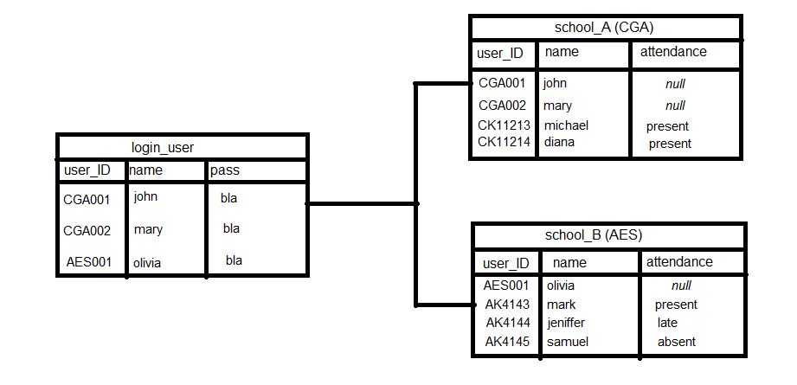
What is Database Schema?
Structure of database in RDBMS
Blueprint of the actual database
Defines, tables, attributes and relationships.
https://stackoverflow.com/questions/42217521/how-to-connect-each-person-in-a-table-to-another-table-respectively-in-a-databas

Slide 25
ER Model – entity relationship Model
Designing database schema – all different tables and attributes in the table
Defining relationships among them
Middleman between actual database implemented and the business requirements
Map out entities, attributes and relationships

Slide 26
Business Requirement
The school system must maintain a database of students, capturing essential details such as their first name, last name, GPA, and a unique student number. Students can enroll in multiple classes, and each class can accommodate multiple students, reflecting a many-to-many relationship. For each class a student takes, their grades should be recorded to track academic performance. Additionally, classes may vary in structure, as some will include exams while others will not. This structure should support flexibility and accuracy in tracking academic records and class configurations.

Slide 27
Problem statement
A school has many students.
Each student has multiple attributes like first name, last name, GPA, student number.
Each student can take multiple classes and classes can contain multiple students.
A student will get a grade for the classes they take.
Some classes will have exams, and some might not.
Notes:
Construct a student database
Learn about different entities, attributes, keys and relationships between tables
Map out all the requirements

Slide 28
solution
Build an ER Model!

Slide 29
Entity
A thing or an object that can be defined and have stored information
Think of them as nouns
They are formed into tables
Example: student, teacher, professor, department, etc.
Student

Slide 30
Entity attributes
Specific information about the entity
They describe the entity
Columns of the table
Name
GPA
Student

Slide 31
Primary key
An attribute that uniquely identifies an entry in the table
Generally primary key is not in a different color
Primary key is underlined to identify in ER diagram
Student_id will be the primary key here
Name
Student_id
GPA
Student

Slide 32
Composite attribute
FName
LName
An attribute that can be broken down into smaller attributes
Like FName and Lname for Name
Main attribute connected to the sub attribues
Name
Student_id
GPA
Student

Slide 33
Multi-valued attributes
FName
LName
An attribute with more than one value for the same entry
Looks like attribute with an extra circle
Students can be included in more than one Clubs
Name
Student_id
GPA
Student
Clubs

Slide 34
Derived attribute
FName
LName
An attribute that can be derived from other attributes
We won’t keep track of it, we could just derive it for analysis
has_honors, derived from GPA
Don’t need to manually enter the value for it
Calculate it at time of retrieval
Circle with dashed border
Name
Student_id
GPA
Student
Clubs
has_honors

Slide 35
Multiple entities
FName
LName
You can have as many entities as you like or require
according to the problem statement
We can have a class entity for storing the
details about class like class_id, name, etc.
Name
Student_id
GPA
Student
Class_id
Class
Clubs
has_honors

Slide 36
relationships
When we have multiple entities, we would want to define how they are related to each other
Define a relationship in a diamond shape
It’s a verb, like takes, works, controls, etc.

Slide 37
Relationships
FName
LName
The student takes a class, or a class is taken by students
Not all students need to take a class (Partial Participation)
A class needs to be taken by students (Total participation)
All classes need some students taking a particular class
Name
Student_id
GPA
Class_id
Class
Total
Takes
Partial
Student
Clubs
has_honors

Slide 38
Relationship attribute
An attribute about the relationship
Here, take relationship will give student a grade
Grade isn't stored on student or class entity; it is only if a student takes it.

Slide 39
Relationship attribute
FName
LName
Name
Student_id
GPA
Grade
Class_id
Class
Total
Takes
Partial
Student
Clubs
has_honors

Slide 40
Relationship cardinality
Number of rows related between two entities
1:1 – A student can take one class, and class can be taken by one student
1:N – A student can take one class and a class can be taken by many students
N: M – A student can take many classes and a class can be taken by any number any number of students
Student and class are in many-to-many relationship
Or a class could be taken by one student, but a student can take any number of classes

Slide 41
Relationship cardinality
FName
LName
Name
Student_id
GPA
Grade
Class_id
Class
Total
Takes
Partial
Student
M
N
Clubs
has_honors

Slide 42
Weak entity
An entity that cannot be uniquely identified by its attributes
It is dependent on another entity
Like, exam is an entity, but exam can’t exist without a class, it must be associated with a class
It’s a double lined rectangle

Slide 43
Identifying relationship
A relationship that serves to uniquely identify the weak entity
It is a double lined diamond shape

Slide 44
FName
LName
Exam_id
Exam
Exam
Name
M
Has
Student_id
GPA
Has
Grade
1
Class_id
Class
Total
Takes
Partial
Student
M
N
Clubs
has_honors

Slide 45
Important note
Whenever we have a weak entity and an identifying relationship, the weak entity always must have a total participation in the relationship.
Means all exams must have a class, but not all classes will have an exam.

Slide 46
Practice ER Modelling
Let’s do an example!

Slide 47
Introduction
Document describing all different pieces of information and relation between them
Usually a paragraph
Make an ER diagram/Model from the document and then convert it into a database
Information -> ER Diagram/Model -> Database Schema

Slide 48
Business Requirements
The university system is structured into departments, each identified by a unique department number (dept_id) and name. Departments consist of multiple instructors and students. Students are uniquely identified by their student number, name, birth date, and age. Similarly, instructors are identified by their name and id. Each instructor is associated with only one department at a time, and every department is managed by a single instructor whose start date in the role must be tracked. Additionally, each department utilizes a subscribed service to support its operations, and these services are identified by a unique service_id and name.

Slide 49
Business requirements
A university is organized into departments. Each department has a unique number (dept_id), name.
Each department has many instructors and many students. Every student has a unique number, name, birth_date and age to identify it. Every instructor has name and id.
An instructor can be working for only one department at a time and each department will be managed by one instructor working it and we want to keep track of start date for them.
Each department has a subscribed service they use for functioning. Each service has a service_id and name.

Slide 50
Steps to build an ER Model
Identify the entities
Identify the attributes for each entity
Identify the primary key, derived attributes, etc.
Identify relationship between each entity set

Slide 51
Complete ER Model
Service_id
Service_name
FName
LName
Name
Exam
Service
N
Student_id
Birth_date
Dept_id
Has
Subscribes
Grade
Dept_name
M
Department
1
has
N
Student
1
1
I_id
has
manage
age
N
1
I_name
Instructor

Slide 52
Converting to ER Diagram
ER Model to ER diagram

Slide 53
Entity
Student
Student

Slide 54
Attributes
Student
Name
Student_Id
FName
LName
Birth_date
Age

Slide 55
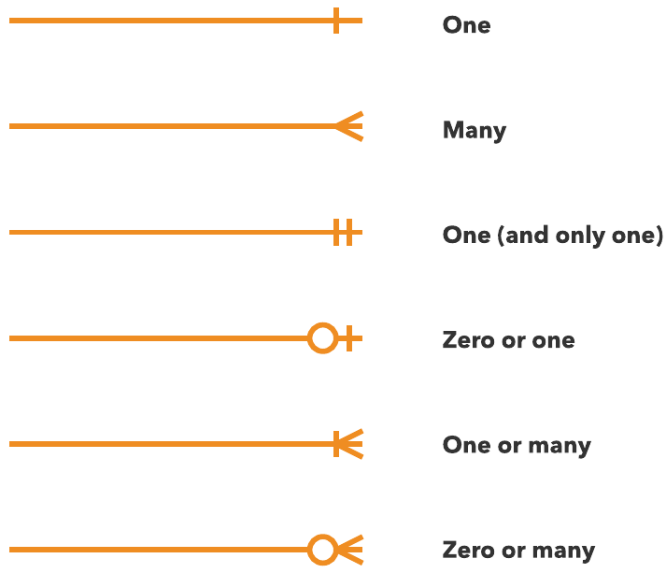
Relationship cardinality

Slide 56
Foreign key
Key to describe the link between 2 tables
It is a primary key of another table that you are linking to
Storing class_id in Exams table to find which classes have exams.

Slide 57

Converting to ER Diagram
Student
Exam
Class
Student_Id
FName
LName
GPA
Clubs
Exam_Id
Class_Id (FK)
Exam_name
Class_Id
Class_name
Grades
Class_Id
Student_Id
Grade

Slide 58
Design ER Diagram
Service_id
Service_name
FName
LName
Name
Exam
Service
N
Student_id
Birth_date
Dept_id
Has
Subscribes
Grade
Dept_name
M
Department
1
has
N
Student
1
1
I_id
has
manage
age
N
1
I_name
Instructor

Slide 59
University ER Diagram
Service
Department
Student
Serice_Id
Dept_Id
Service_name
Dept_Id
I_Id (FK)
Dept_name
Student_Id
FName
LName
Birth_date
Instructor
Grades
I_Id
Dept_Id (FK)
I_name
Class_Id
Student_Id
Grade

Slide 60
Summary
ER Model contains, entities, attributes and relationships.
ER Diagram/Model is the middleman between business requirement and the actual implementation of the database schema.
Primary Key is the unique attribute to identify every row in the table.
Foreign key is an attribute that links the table values to another table using their primary key

